Slide 1
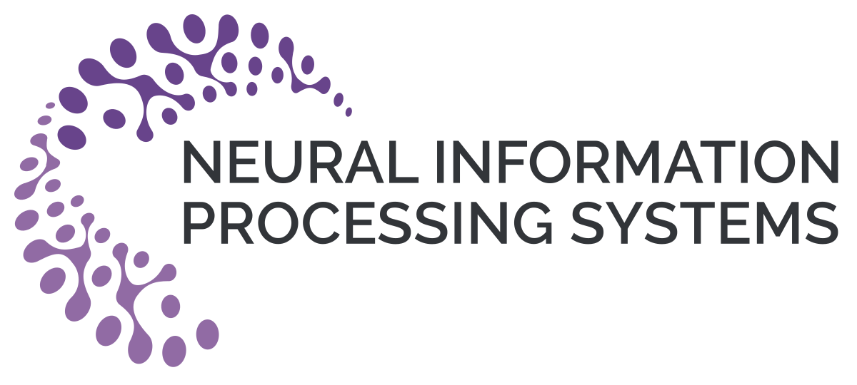
Iterative Deep Graph Learning for Graph Neural Networks: Better and Robust Node Embeddings
Yu Chen
Rensselaer Polytechnic Institute
hugochan2013@gmail.com
Lingfei Wu
IBM Research
lwu@email.wm.edu
Mohammed J. Zaki
Rensselaer Polytechnic Institute
zaki@cs.rpi.edu

Slide 2
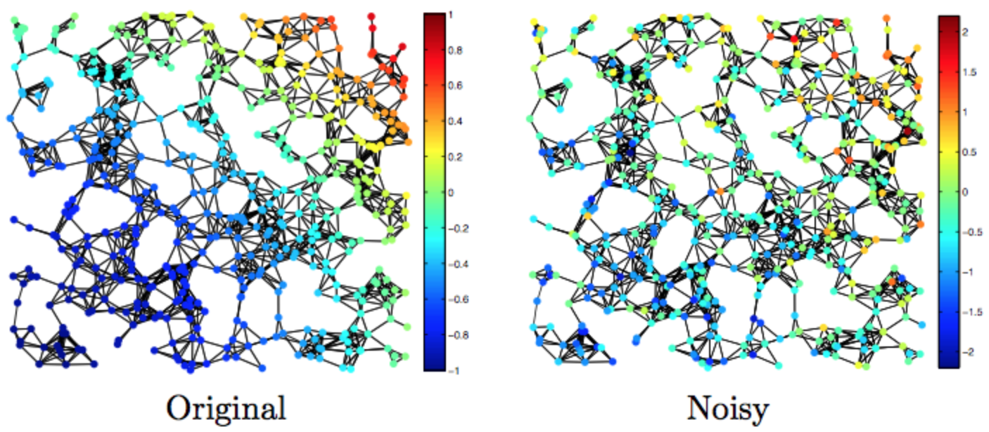
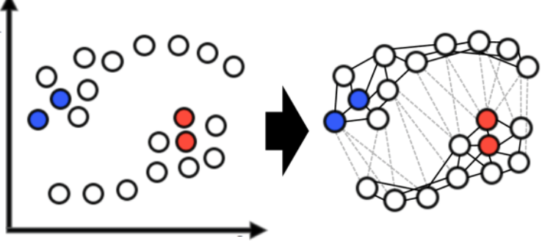
Motivation
GNNs are powerful, unfortunately, it requires graph-structured data available.
Questionable if the given intrinsic graph-structures are optimal (i.e., noisy, incomplete, etc.) for the downstream tasks.
Many applications (e.g., NLP tasks) may only have non-graph structured data or even just the original feature matrix, requiring additional graph construction.
Notes:
Despite GNN’s powerful ability in learning expressive node embeddings, unfortunately, they can only be used when graph-structured data is available.
Most existing GNN methods assume the input graph topology is perfect, which is not necessarily true in practice.
This is because the real-word graphs are often noisy due to the error-prone data measurement or collection.
And the graph construction process might not be ideal for the downstream task.
This motivates us to learn graph structure supplementary to the initial graph.
Furthermore, many applications such as those in NLP may not have graph-structured data available, requiring a lot of domain expertise for manual graph construction.
This raises a question: can we do automatic graph construction from raw data features?

Slide 3
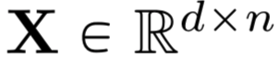
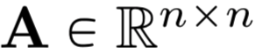
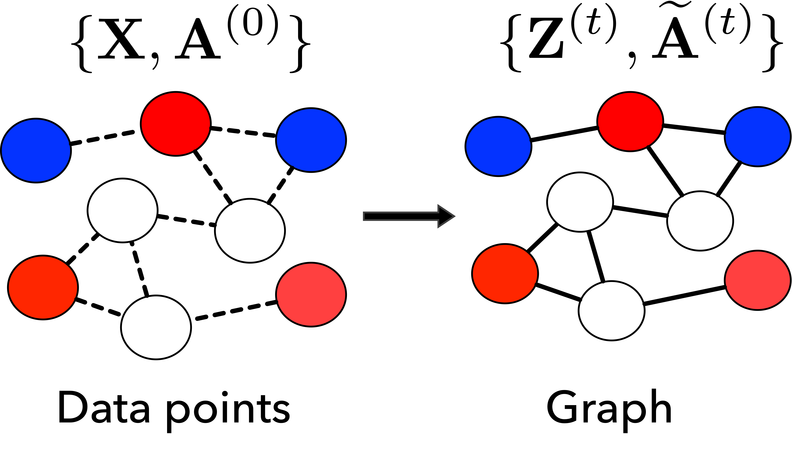
Problem Formulation
Input: a set of n objects associated with a feature matrix
and an (optional and potentially noisy) initial graph topology.
Output: an adjacency matrix and node embeddings with respect to the downstream prediction task.
Notes:
All these issues motivate our work on graph learning for GNNs.

Slide 4
Contributions
We propose a novel end-to-end graph learning framework (IDGL) for jointly and iteratively learning the graph structure and graph embedding.
We further propose a scalable version of IDGL, namely IDGL-Anch, which achieves linear complexity in both computational time and memory consumption with respect to the number of graph nodes.
Experimental results demonstrate the effectiveness and robustness of our models which can cope with both transductive and inductive learning.
Notes:
We propose a novel end-to-end graph learning framework (IDGL) for jointly and iteratively learning the graph structure and graph embedding. IDGL dynamically stops when the learned graph structure approaches the optimized graph (for prediction). To the best of our knowledge, we are the first to introduce the iterative learning for graph structure learning.
Combining the anchor-based approximation technique, we further propose a scalable version of IDGL, namely IDGL-Anch, which achieves linear complexity in both computational time and memory consumption with respect to the number of graph nodes.
Experimental results show that our models consistently outperform or match state-of-the-art baselines on various downstream tasks. More importantly, IDGL can be more robust to adversarial graph examples and can cope with both transductive and inductive learning.

Slide 5
Graph Structure and Embedding Learning: A Unified Perspective
A sketch of the IDGL framework
Downstream task prediction
Input data
Jointly learn the graph structure and embeddings.
Better node embeddings -> better graph structure
Better graph structure -> better node embeddings.
Dynamically stop the iterative learning procedure.
Graph structure
Graph Learner
GNN
Graph embeddings
Repeat until condition satisfied
Notes:
We propose a novel iterative deep graph learning framework for jointly learning the graph structure and graph embedding that are optimized toward the downstream prediction task.
As shown in the diagram, the key rationale is that we believe better node embeddings help learn a better graph structures and a better graph structure helps learn better node embeddings.
Our method can iteratively search for hidden graph structure that augments the initial graph structure, and dynamically stop when the learned graph structure approaches the optimized graph with respect to the downstream task.

Slide 6
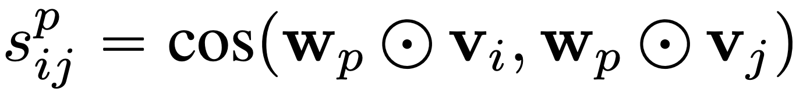
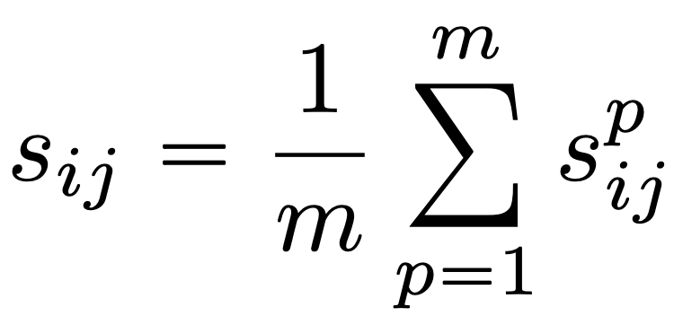
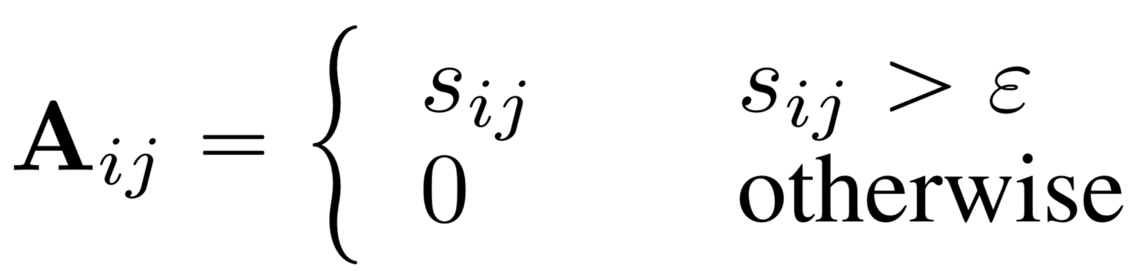
Graph Learning as Similarity Metric Learning
Multi-head weighted cosine similarity
Graph similarity metric learning.
Graph sparsification via ɛ-neighborhood.
Obtaining a symmetric sparse non-negative adjacency matrix.
Similarity for p-th
perspective
m independent weight vectors
Taking average of m similarity scores
Symmetric sparse non-negative adjacency matrix
Notes:
We cast the graph learning problem as similarity metric learning.
We design a weighted cosine similarity function for computing the similarity for any pair of nodes.
W is a learnable weight vector which has the same dimension as the input vectors vi and vj, and learns to highlight different dimensions of the vectors.
We also introduce a multi-head strategy where each perspective considers one part of the semantics captured in the vectors.
Considering many underlying graph structures are much more sparse than a fully connected graph, which is not only computationally expensive but also might introduce noise (i.e., unimportant edges), we apply epsilon-neighborhood for obtaining a symmetric sparse non-negative adjacency matrix.

Slide 7
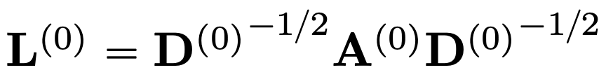
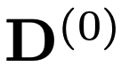
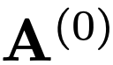
Incorporating the Initial Graph Structure
Learning a “shift” from the initial graph structure
Initial graph structure
Learned graph structure at t-th iteration
Assumption: optimized graph structure is potentially a shift from the initial graph structure.
We combine the learned graph with the initial graph.
If such an initial graph is not available, we instead use a kNN graph.
Normalized adjacency matrix
is the degree matrix of .
Notes:
Although the initial graph could be noisy, it typically still carries rich and useful information regarding true graph topology.
Ideally, the learned graph structure could be supplementary to the original graph topology to formulate an optimized graph for GNNs with respect to a downstream task.
with the mild assumption that the optimized graph structure is potentially a shift from the initial graph structure, we combine the learned graph with the initial graph.
hyperparameter lambda is used to balance the trade-off between the learned graph structure and the initial graph structure.
If such an initial graph structure is not available, we instead use a kNN graph constructed based on raw node features using cosine similarity.

Slide 8
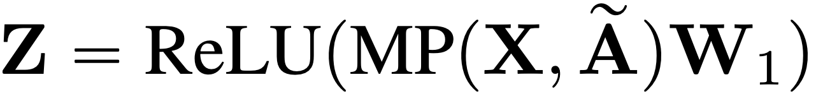
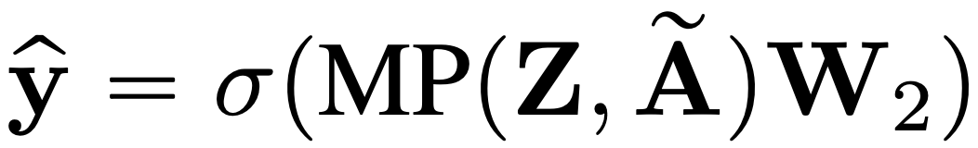
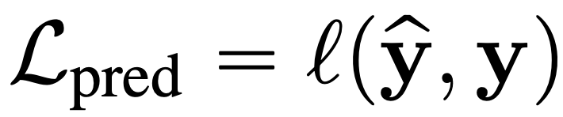
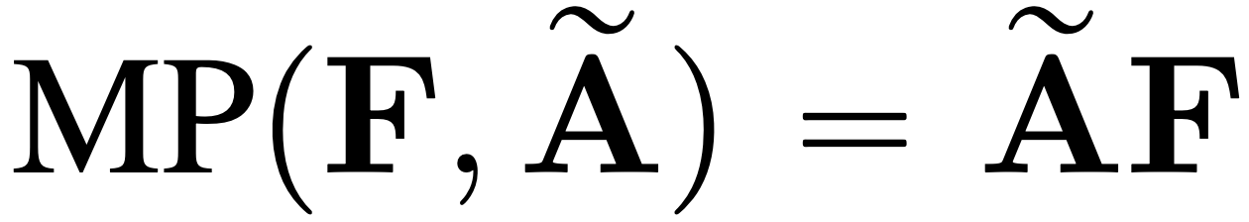
Graph Node Embeddings and Prediction
Task-dependent prediction
Normalized learned adjacency matrix
Node embedding
Task-dependent output function
Our graph learning framework is agnostic to various GNNs.
We adopt two-layered GCN in this work.
First layer: node feature -> node embedding.
Second layer: node embedding -> output space.
Raw node feature matrix
Task-dependent prediction loss
Task-dependent loss function
Notes:
Our graph learning framework is agnostic to various GNNs.
In this work, we adopt two-layered GCN where the first layer is used for computing the node embeddings and the second layer is used for producing the output.

Slide 9
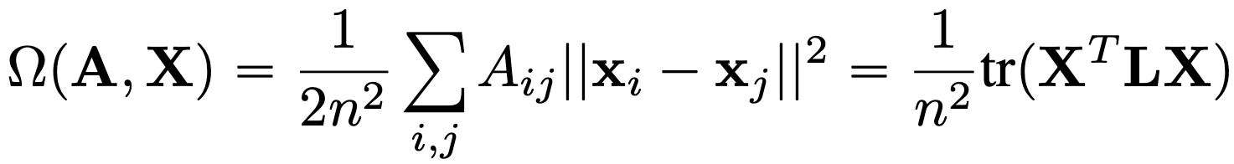
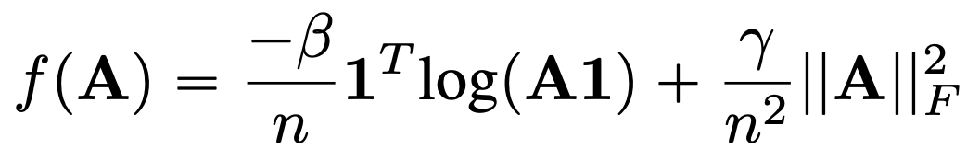
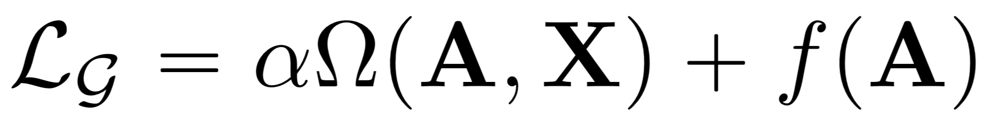
Graph Regularization
Smoothness
Control the smoothness, connectivity and sparsity of the resulting learned graph.
A is the adjacency matrix obtained through graph similarity metric learning.
Connectivity
Sparsity
Notes:
In order to control the quality of the learned graph, inspired by previous works in the GSP field, we leverage adapted graph regularization for controlling the smoothness, connectivity and sparsity of the learned graph.

Slide 10
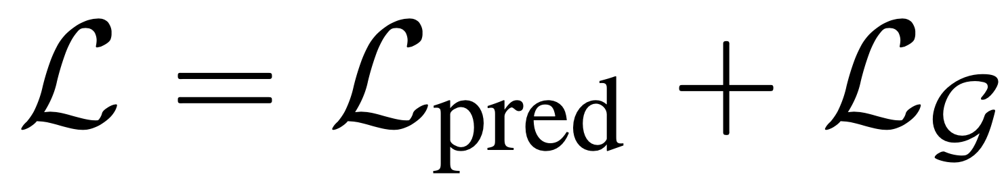
Joint Graph Structure and Representation Learning
Minimizing a joint loss function
Minimize a joint loss function combining both the prediction loss and the graph regularization loss.
Task-dependent prediction loss
Graph regularization loss
Notes:
We minimize a joint loss function combining both the prediction loss and the graph regularization loss.

Slide 11
Revisit the Iterative Learning Idea
A sketch of the IDGL framework
Downstream task prediction
Input data
Jointly learn the graph structure and embeddings.
Better node embeddings -> better graph structure
Better graph structure -> better node embeddings.
Dynamically stop the iterative learning procedure.
Graph structure
Graph Learner
GNN
Graph embeddings
Repeat until condition satisfied
Notes:
We propose a novel iterative deep graph learning framework for jointly learning the graph structure and graph embedding that are optimized toward the downstream prediction task.
As shown in the diagram, the key rationale is that we believe better node embeddings help learn a better graph structures and a better graph structure helps learn better node embeddings.
Our method can iteratively search for hidden graph structure that augments the initial graph structure, and dynamically stop when the learned graph structure approaches the optimized graph with respect to the downstream task.

Slide 12
Iterative Deep Graph Learning Framework
The overall architecture of IDGL
A graph learning network for generating a graph topology
A graph embedding network for generating node embeddings
A graph regularization network
A prediction network for the downstream task
Notes:
Our framework consists of a graph learning network for generating a graph topology based on node embeddings, a graph embedding network for generating node embeddings based on graph topology, a graph regularization network for controlling the quality of the learned graph, and a prediction network for the downstream task. Combining the anchor-based approximation technique, we further propose a scalable version of IDGL, namely IDGL-Anch, which significantly reduces the time and space complexity of IDGL without compromising the performance.

Slide 13
Better Scalability with IDGL-Anch
Extend IDGL to more scalable IDGL-Anch
We randomly sample a small set of s anchors from n nodes.
Some nice properties:
Node-anchor affinity matrix can be efficiently computed. O(ns)
Message passing is performed on the node-anchor bipartite graph. O(ns)
Graph regularization is performed on the anchor graph. O(ns^2)
Similarity metric function is expensive (O(n^2)).
Anchor-based approximation techniques.
Linear complexity in both computational time and memory consumption with respect to the number of graph nodes.
Notes:
We minimize a joint loss function combining both the prediction loss and the graph regularization loss.

Slide 14
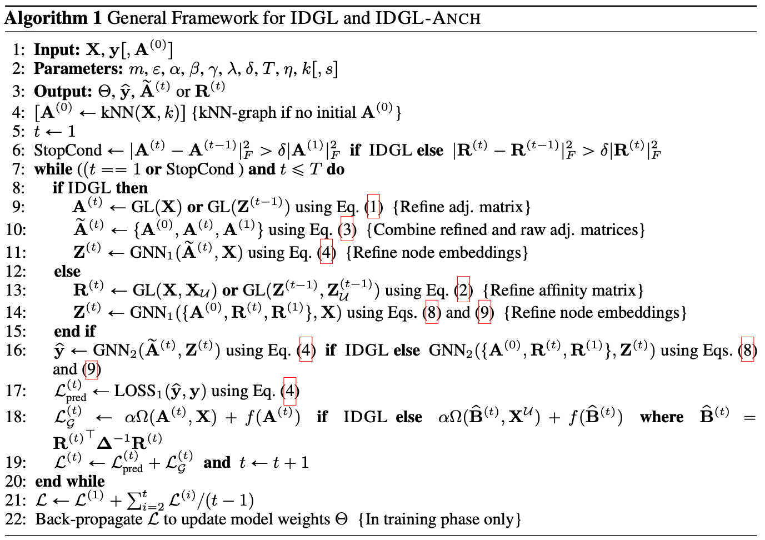
Full Algorithm
Repeatedly refining the adjacency matrix with the updated node embeddings.
Repeatedly refining the node embeddings with the updated adjacency matrix.
After all iterations, the overall loss will be back-propagated through all previous iterations to update the model parameters.

Slide 15
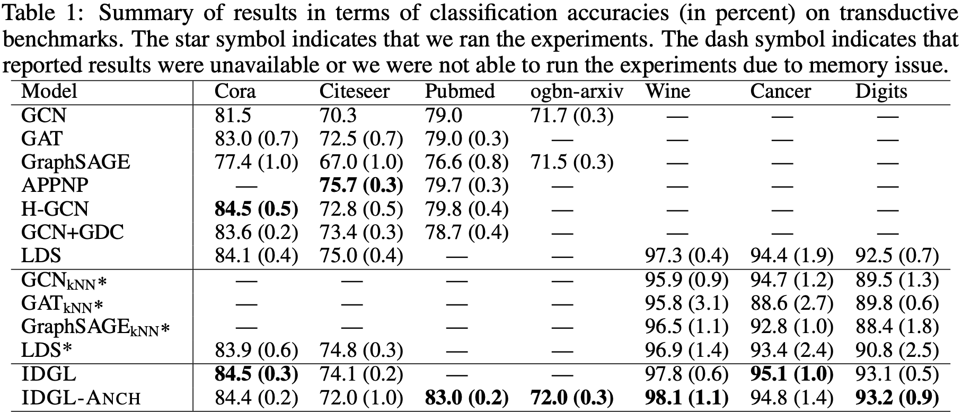
Experimental Results: Transductive Setting
Notes:
The experimental results on transductive setting show that IDGL outperforms all baselines in 4 out of 5 benchmarks, which demonstrates its effectiveness.
Compared to IDGL, IDGL-Anch is more scalable and can achieve comparable or even better results.

Slide 16
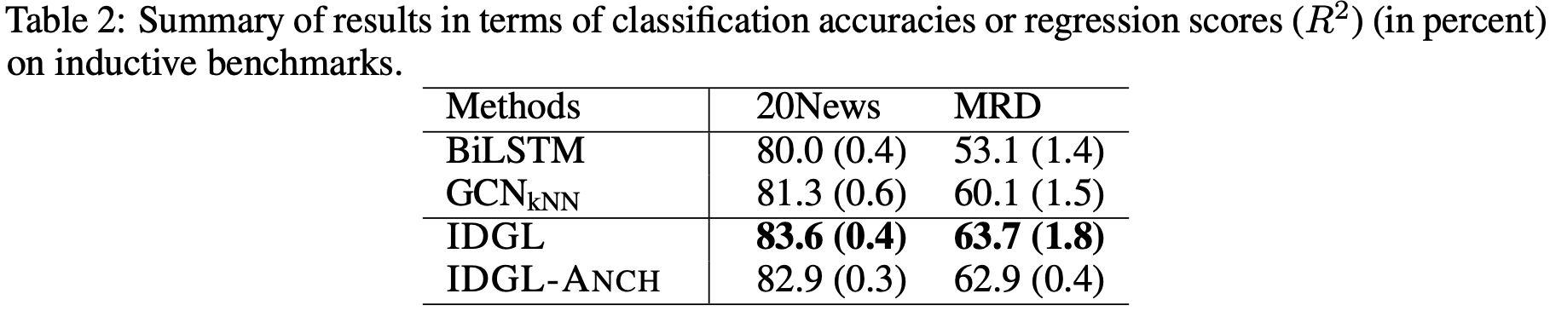
Experimental Results: Inductive Setting
Notes:
Unlike our main graph learning baseline LDS which cannot handle inductive setting where there are unseen nodes/graphs in the testing set, the good performance on two text benchmarks verifies the capability of our approach on inductive learning.

Slide 17
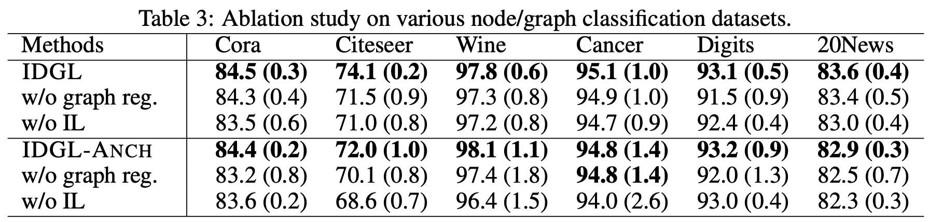
Experimental Results: Ablation Study
Notes:
Unlike our main graph learning baseline LDS which cannot handle inductive setting where there are unseen nodes/graphs in the testing set, the good performance on two text benchmarks verifies the capability of our approach on inductive learning.

Slide 18
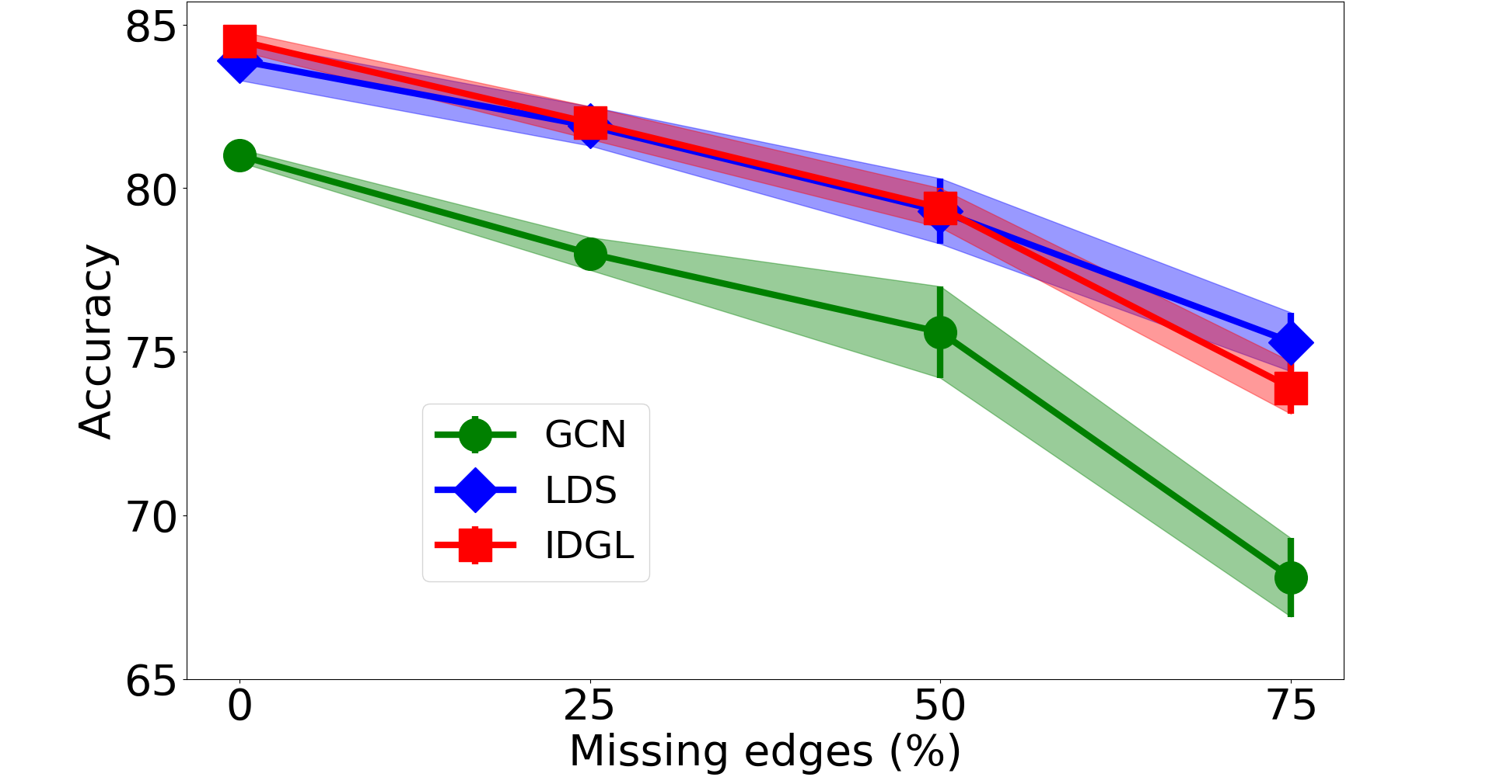
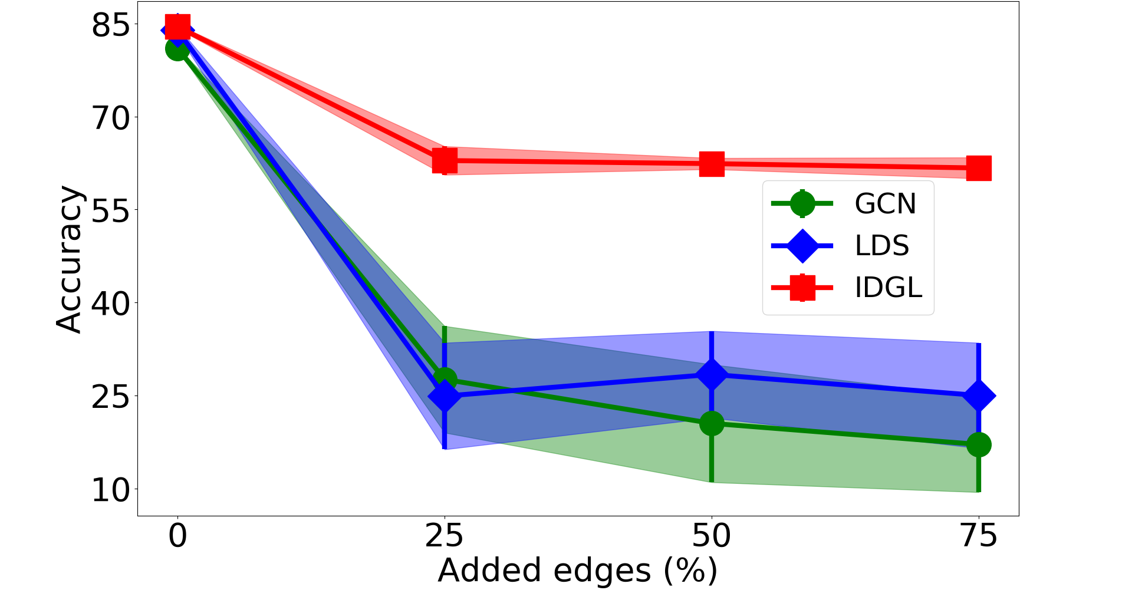
Experimental Results: Robustness Testing
Figure 1. Test accuracy (± standard deviation) in percentage for edge deletion and addition scenarios on Cora test set.
Notes:
To evaluate the robustness of IDGL to adversarial graphs, we construct graphs with random edge deletions or additions.
Compared to GCN and LDS, IDGL achieves better or comparable results in both scenarios.
While both GCN and LDS completely fail in the edge addition scenario, IDGL is still able to perform reasonably well.

Slide 19
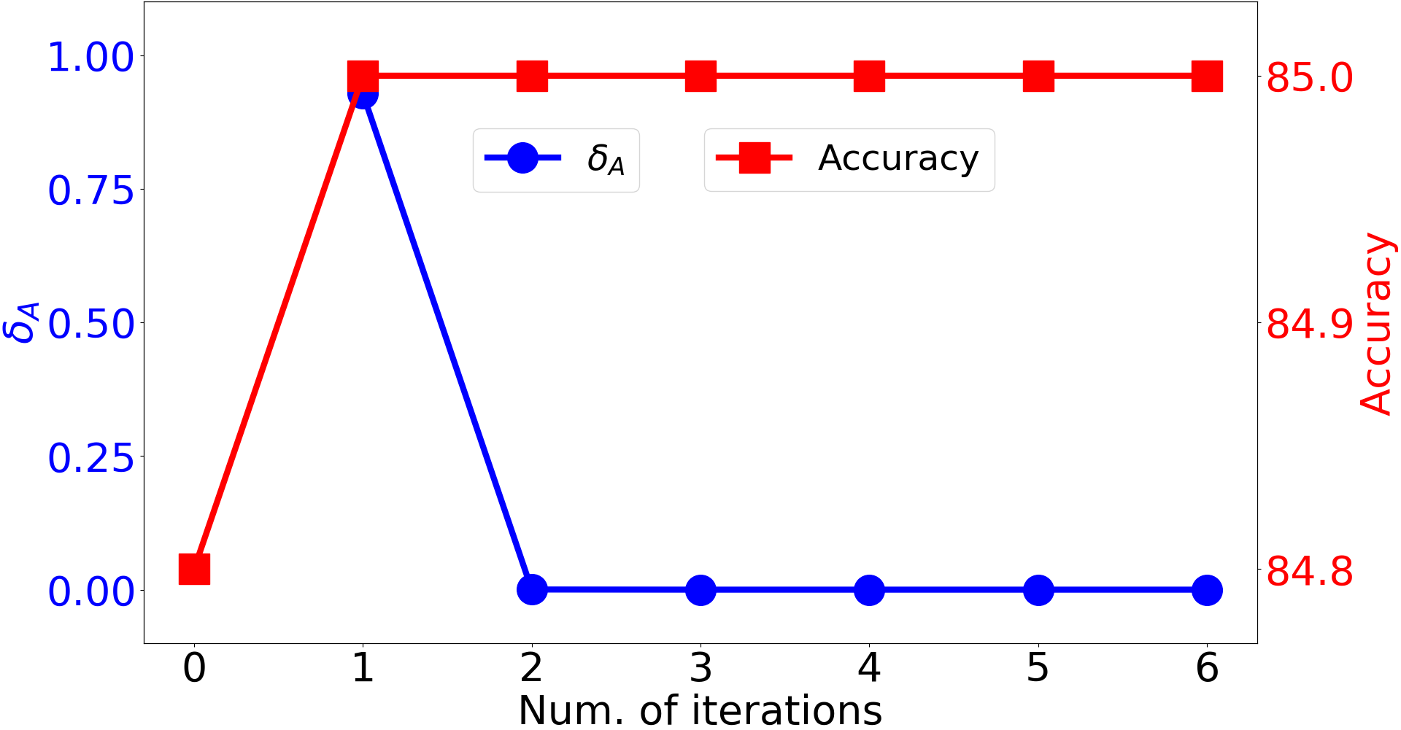
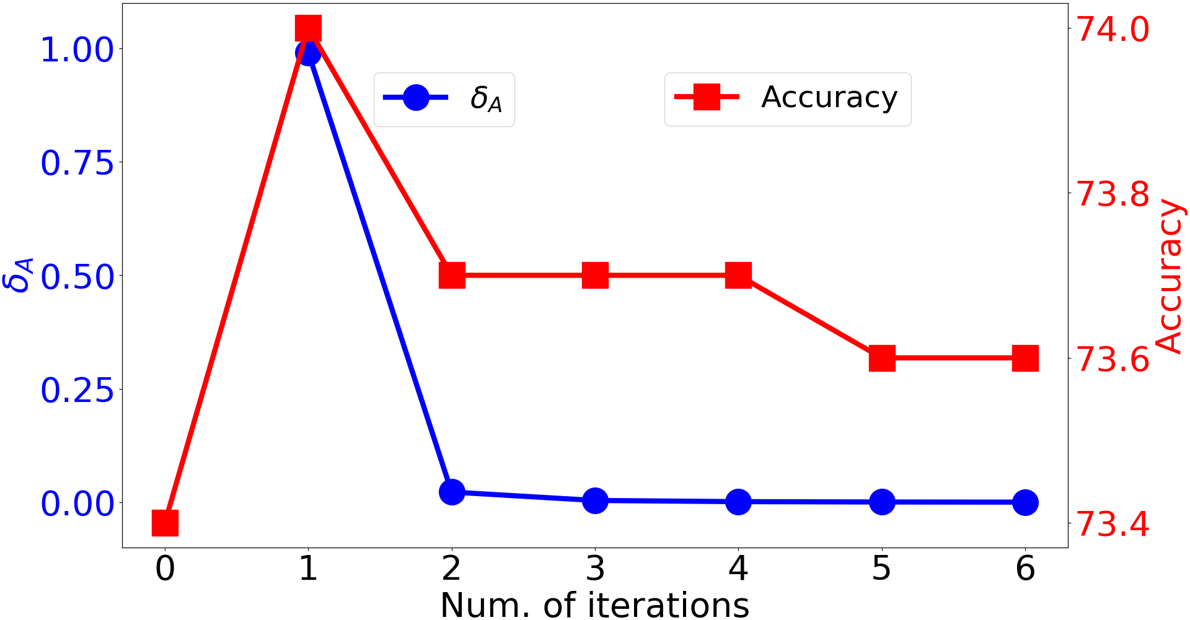
Experimental Results: Convergence Testing
(a) Cora
(b) Citeseer
Figure 2. Convergence study on Cora and Citeseer (single run results).
Notes:
To evaluate the robustness of IDGL to adversarial graphs, we construct graphs with random edge deletions or additions.
Compared to GCN and LDS, IDGL achieves better or comparable results in both scenarios.
While both GCN and LDS completely fail in the edge addition scenario, IDGL is still able to perform reasonably well.

Slide 20
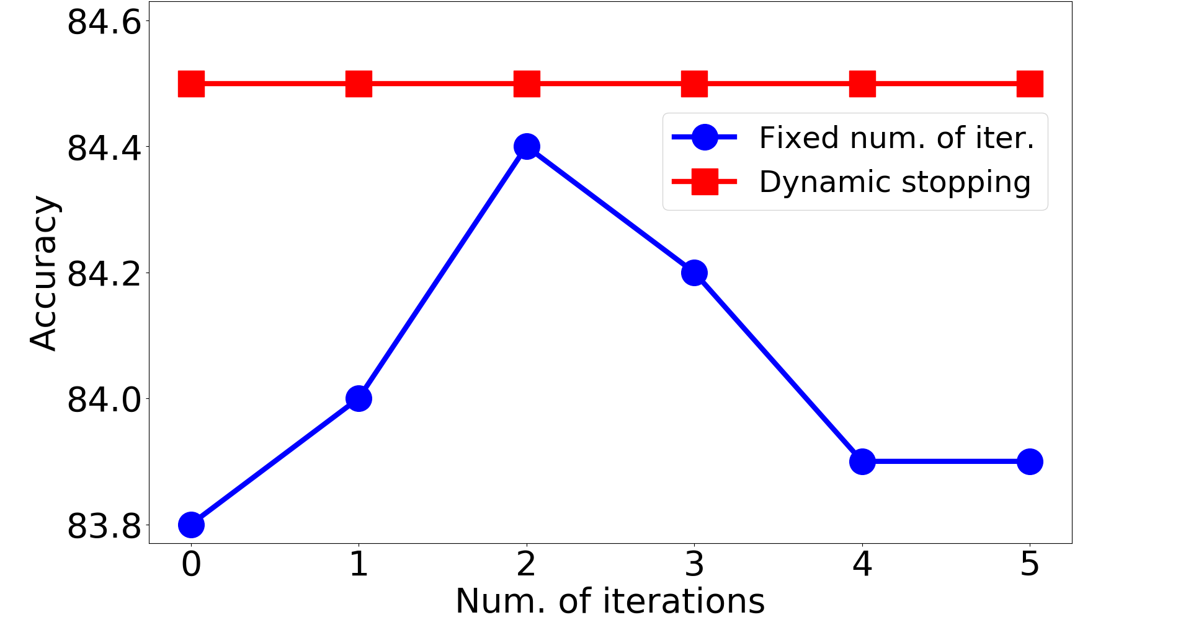
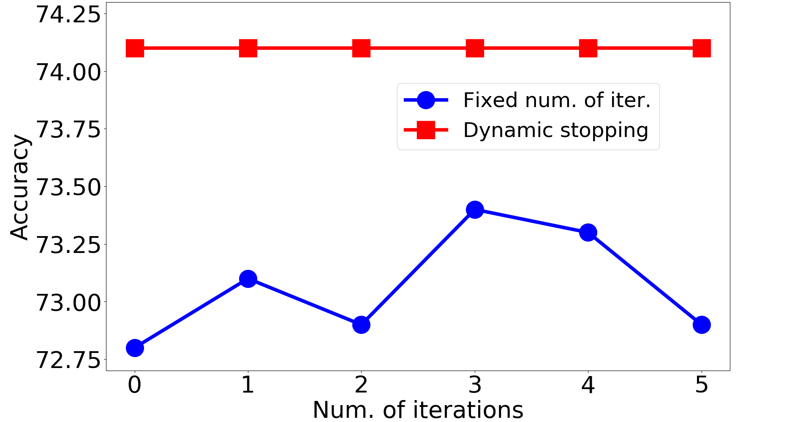
Experimental Results: Stopping Strategy
(a) Cora
(b) Citeseer
Figure 3. Performance comparison (i.e., test accuracy in %) of two different stopping strategies on Cora and Citeseer.
Notes:
To evaluate the robustness of IDGL to adversarial graphs, we construct graphs with random edge deletions or additions.
Compared to GCN and LDS, IDGL achieves better or comparable results in both scenarios.
While both GCN and LDS completely fail in the edge addition scenario, IDGL is still able to perform reasonably well.

Slide 21
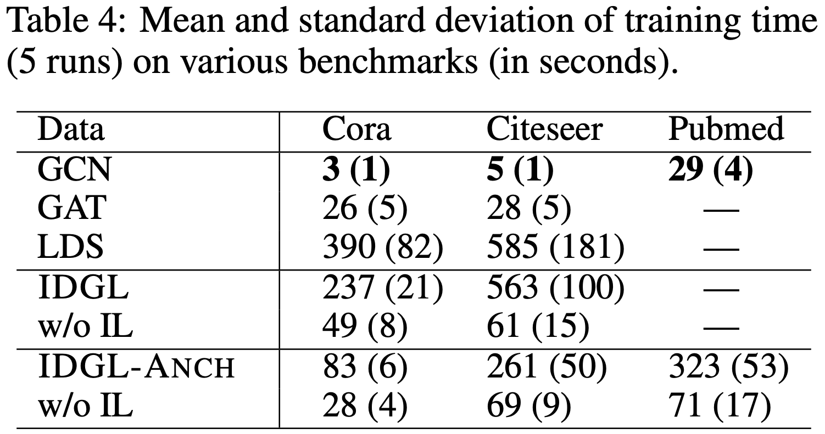
Experimental Results: Timing
Notes:
To evaluate the robustness of IDGL to adversarial graphs, we construct graphs with random edge deletions or additions.
Compared to GCN and LDS, IDGL achieves better or comparable results in both scenarios.
While both GCN and LDS completely fail in the edge addition scenario, IDGL is still able to perform reasonably well.

Slide 22
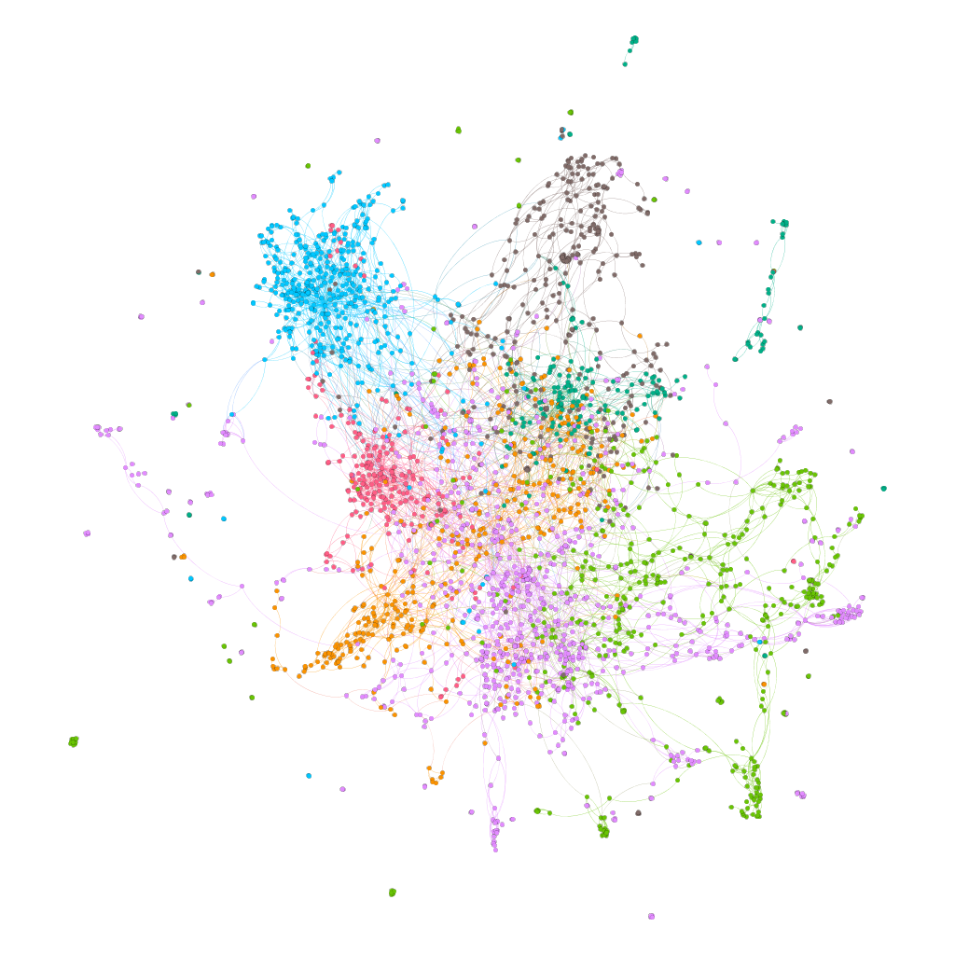
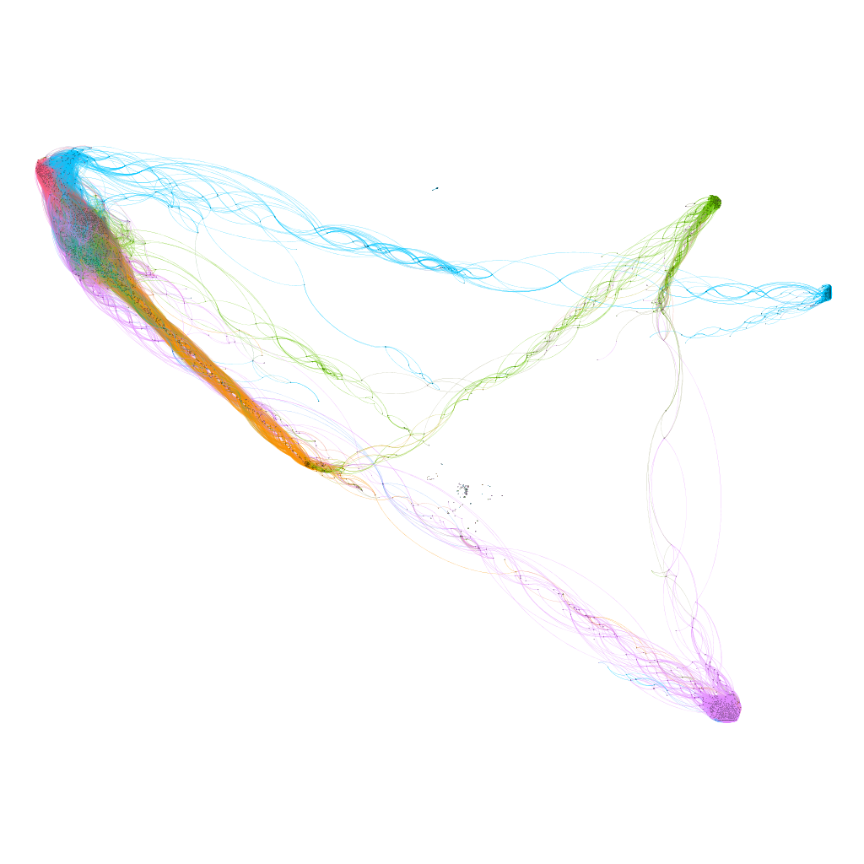
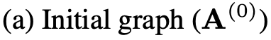
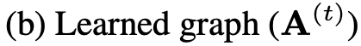
Experimental Results: Graph Visualization
Figure 4. Visualization of the initial graph and the learned graph on Cora. Colors indicate different node labels.
Notes:
To evaluate the robustness of IDGL to adversarial graphs, we construct graphs with random edge deletions or additions.
Compared to GCN and LDS, IDGL achieves better or comparable results in both scenarios.
While both GCN and LDS completely fail in the edge addition scenario, IDGL is still able to perform reasonably well.

Slide 23
Conclusion & Future Work
We proposed a novel end-to-end graph learning framework for jointly and iteratively learning the graph structure and graph embedding that are optimized towards the prediction task at hand.
Our extensive experiments demonstrate the effectiveness of the proposed models.
Future work includes exploring more effective and scalable techniques for handling more challenging scenario where both graph topology and node feature matrix are noisy.

Slide 24
Thank you!
Code is publicly available at
https://github.com/hugochan/IDGL.
Notes:
The implementation of our model is publicly available. Thank you for your attention!

Slide 25
Backup

Slide 26
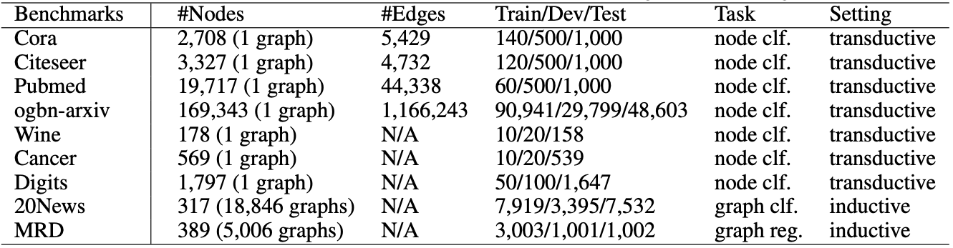
Experimental Setup
Table 5: Data statistics. (clf. indicates classification and reg. indicates regression.)
We ran our experiments 5 times with different random seeds.

